Slide 1
Living in the IT Era
Legal, Social and Ethical Issues in Technology

Slide 2
Topics of Importance
Ethical Issues for Safety and Security
Digital Divide
Legal use of Digital Media

Slide 3
Ethical Issues for Safety and Security
Social Networking
Acceptable Use Policies
Netiquette
Cyber bullying Student Data
Internet Privacy

Slide 4
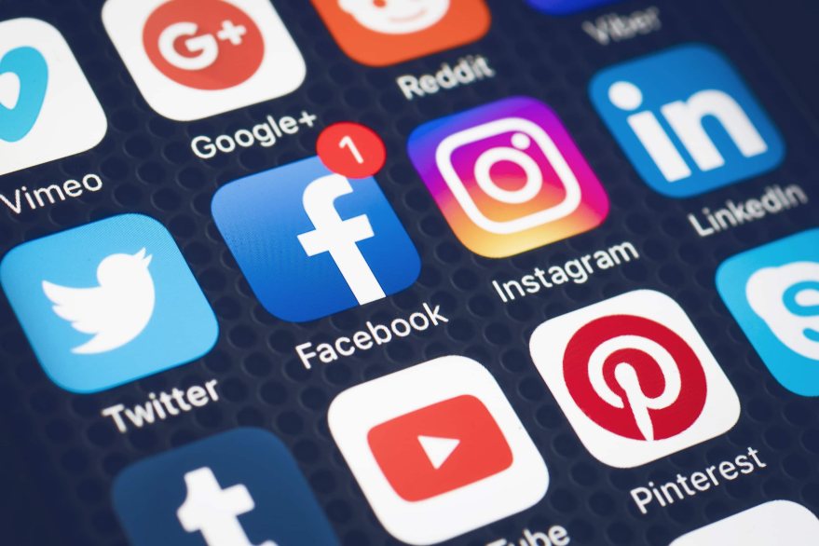
Social Networking
A broad class of websites and services that allow you to connect with others online as well as meet people with similar interests or hobbies.

Slide 5
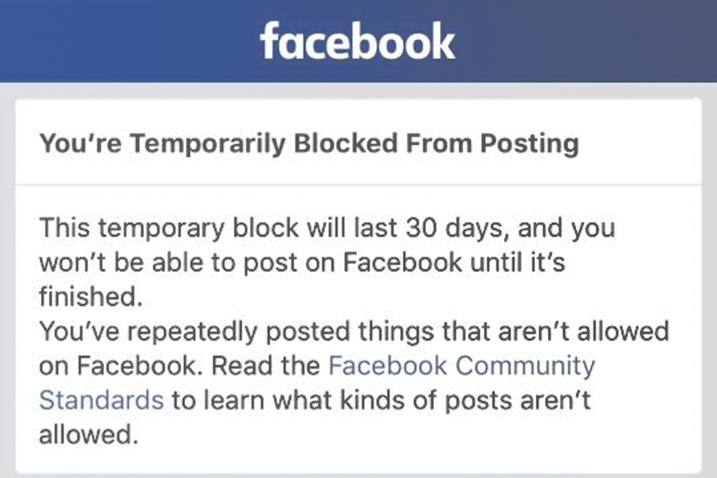
Acceptable Use Policies
This is a policy set up by the network administrator or other school leaders that are set to agree with their technology needs and safety concerns.

Slide 6
Netiquette
Refers to the online code of what is appropriate and in good taste for internet users
Contraction of the words "net" (from internet) and "etiquette.
Poor choices online can lead to bad consequences.

Slide 7
Cyber Bullying
Bullying which is carried out through a social networking site, but can also include through other technologies such as text messaging.
Different from regular bullying: more invasive, wider audience, can be done at anytime, anyplace.
One of the faster growing bullying trends among teens today.

Slide 8
Student Data
New computer technologies for gathering, storing, manipulating, and communicating data are revolutionizing the use and spread of information
Student's have the right to control use of information that is related to themselves.

Slide 9
Internet Privacy
Every move made online is being tracked.
IP addresses can trace location.
Be aware of what private information you make available online
Protect passwords and do not leave confidential information up for others to see.

Slide 10
Digital Divide
The digital divide is the lack of access to information and communications technologies by segments of the community
Gender
Socio Economic
Race
Resource Equity
Teacher Bias

Slide 11
Gender
Women and men use internet differently . Men are more driven by IT, where as women are more passive in their role as technology users.
Men favor video games
Women favor chatting, email

Slide 12
Socio Economic
Many people living in poverty do not get the same technological resources as others, leaving them farther behind in the digital divide. A lot of technology is expensive and people living in poverty cannot afford them, as they are not a necessity.

Slide 13
Race
Disadvantaged minority groups fall behind in informational technology skills because of limited access due to their socio economic standings.
This can cause an even larger digital divide because the minorities will not have practice with informational technology skills which are one of the top careers of today.

Slide 14
Resource Equity
Having equal access to technology
This is important part of a quality education
Equal access is important to help bridge the gap in the digital divide.

Slide 15
Teacher Bias
The way a teacher teaches with technology and uses it in the classroom can affect how students use and understand using technology.

Slide 16
Legal Use of Digital Media
Copyright
Fair Use
Creative Commons

Slide 17
Copyright
Gives creator right to reproduce, distribute, perform and display his/her work.
Copyright protection protects the creator from others stealing ideas as their own and taking money and association of what is rightfully theirs.

Slide 18
Fair Use
Fair use is a doctrine in the United States copyright law that allows limited use of copyrighted material without requiring permission from the right holders.
Four factors to look at: purpose, nature, amount, effect.

Slide 19
Creative Commons
Creative Commons' licenses allow others to copy and distribute the work under specific conditions, and general descriptions, legal clauses and HTML tags for search engines are provided for several license options. One of the primary uses of a Creative Commons license is to allow people to copy the material as long as it is not used for commercial use.

